Slide 1
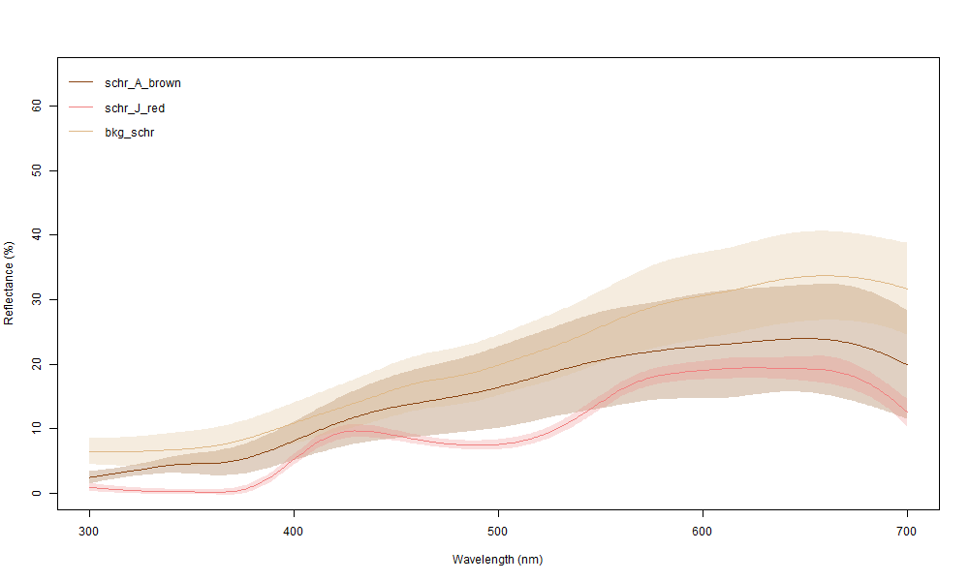
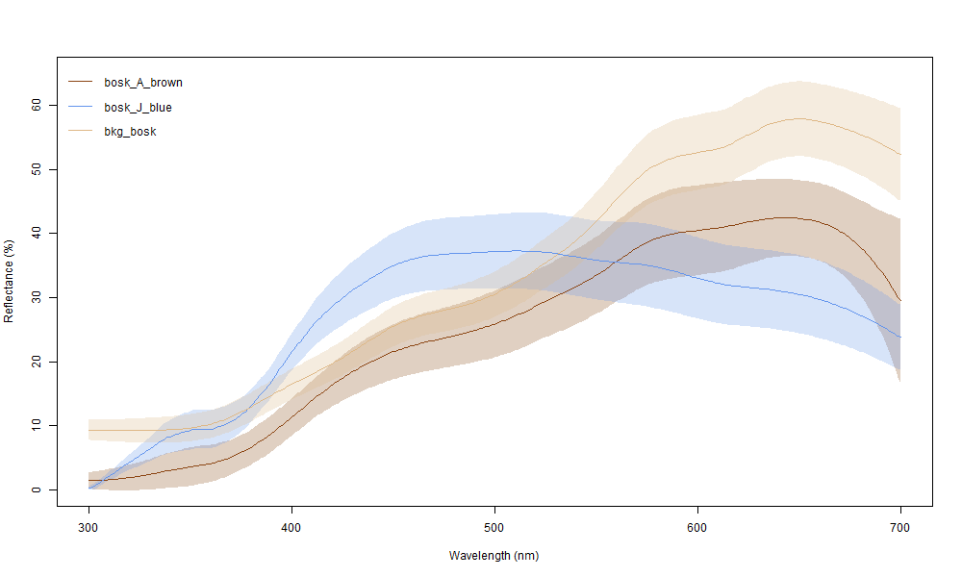
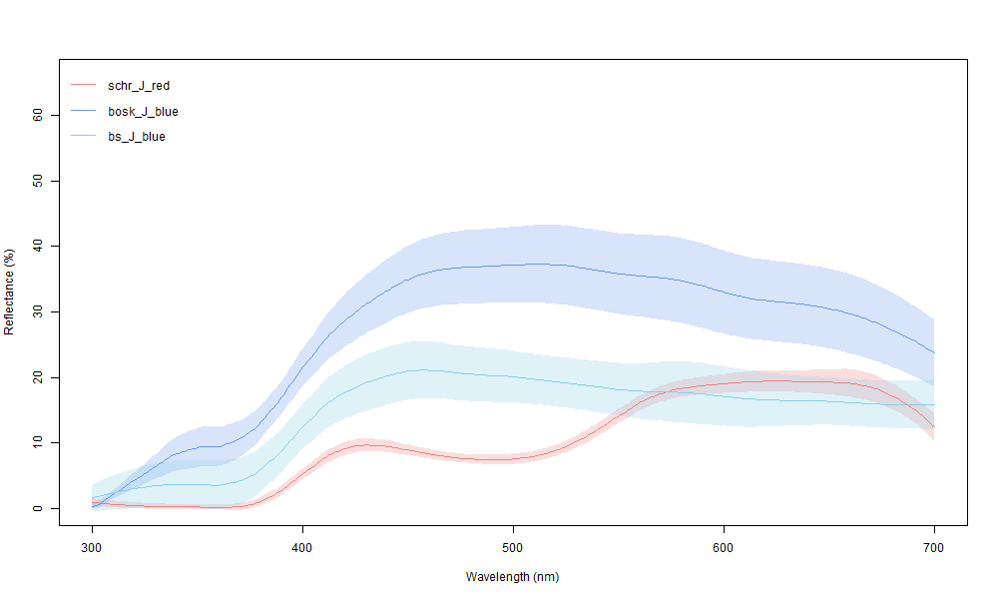
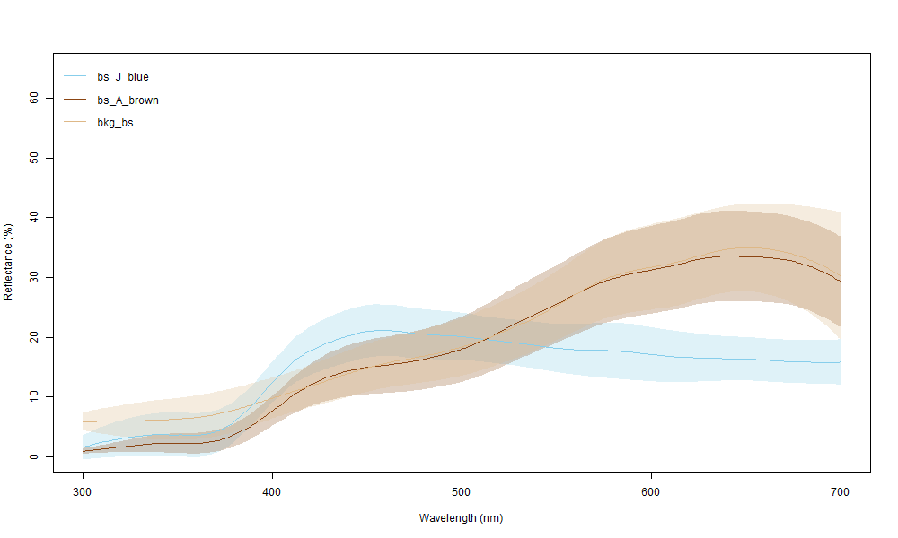
Notes:
NEW

Slide 2
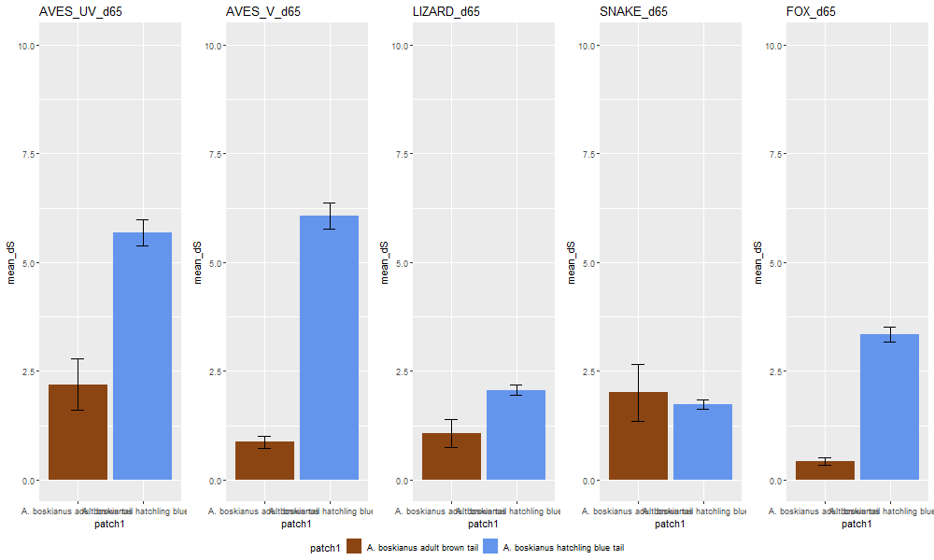
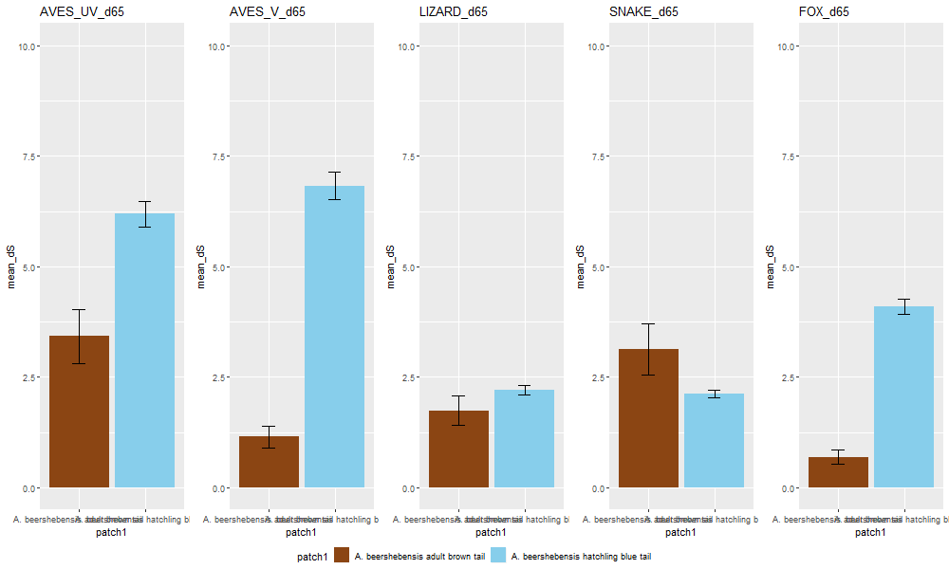
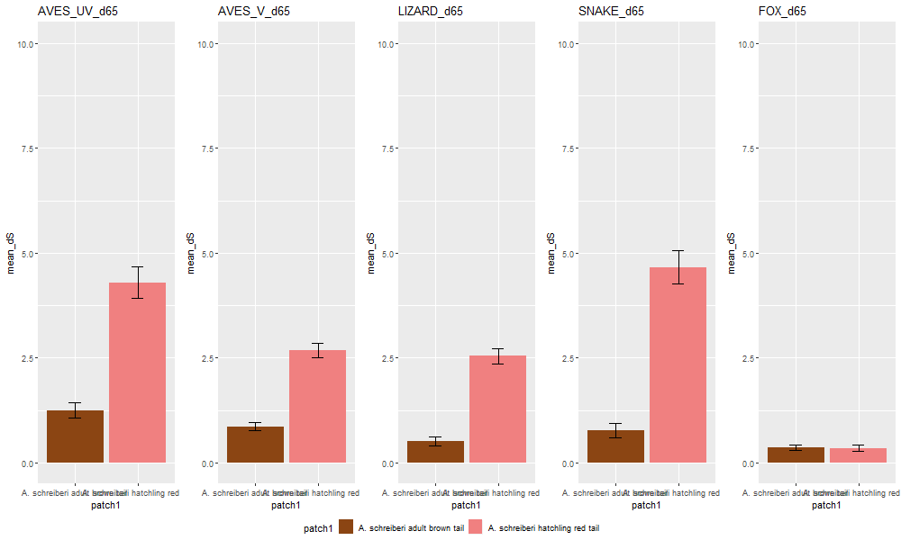
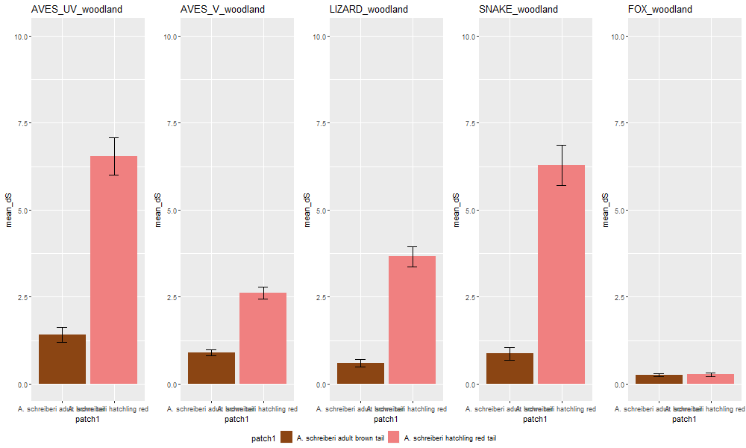
DAYLIGHT- BOSKIANUS
DAYLIGHT- BEERSHEBENSIS
DAYLIGHT- SCHREIBERI
SHADE- SCHREIBERI
Notes:
NEW

Slide 3
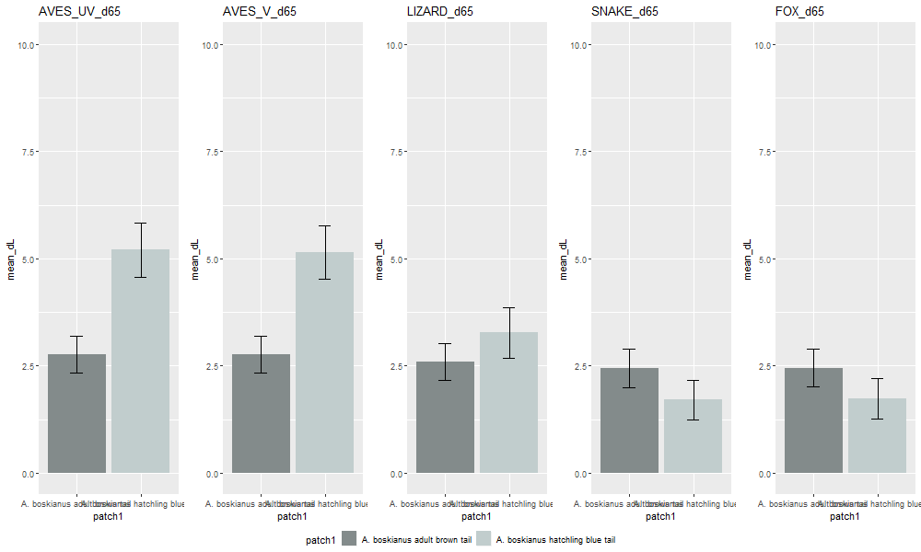
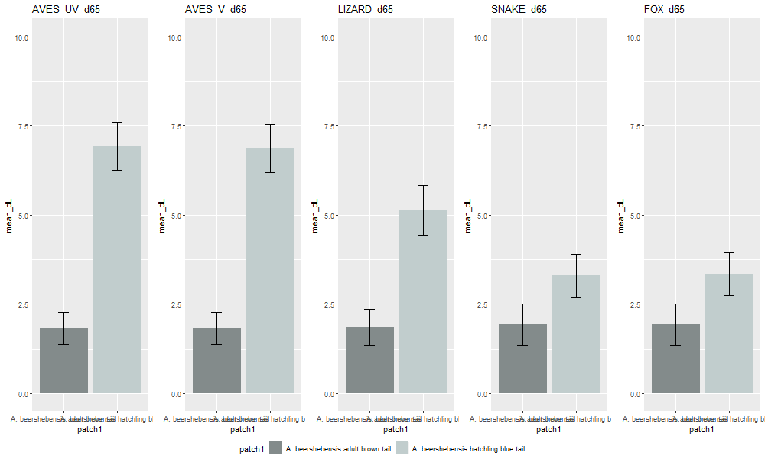
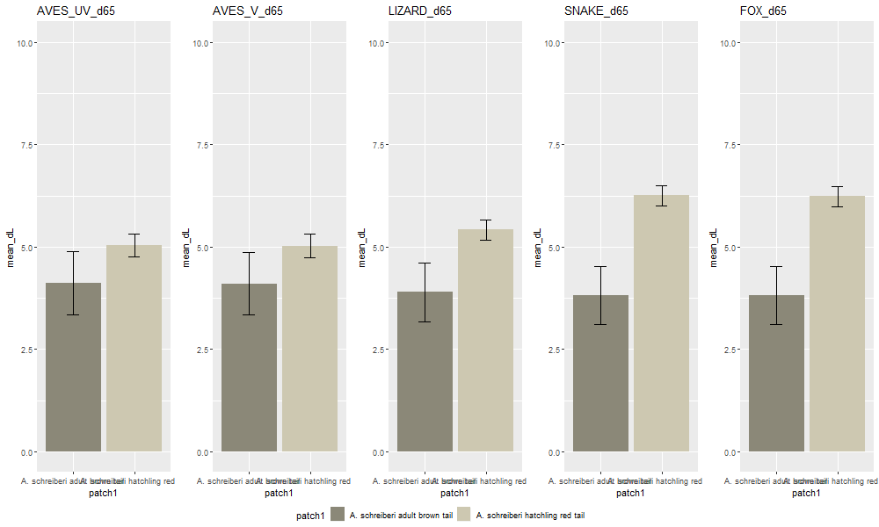
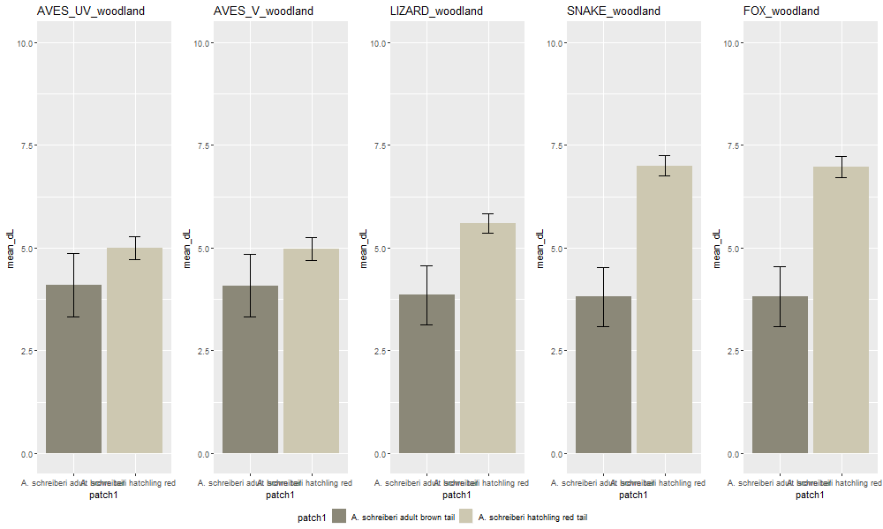
DAYLIGHT- BOSKIANUS
DAYLIGHT- BEERSHEBENSIS
DAYLIGHT- SCHREIBERI
SHADE- SCHREIBERI
Notes:
NEW

Slide 4
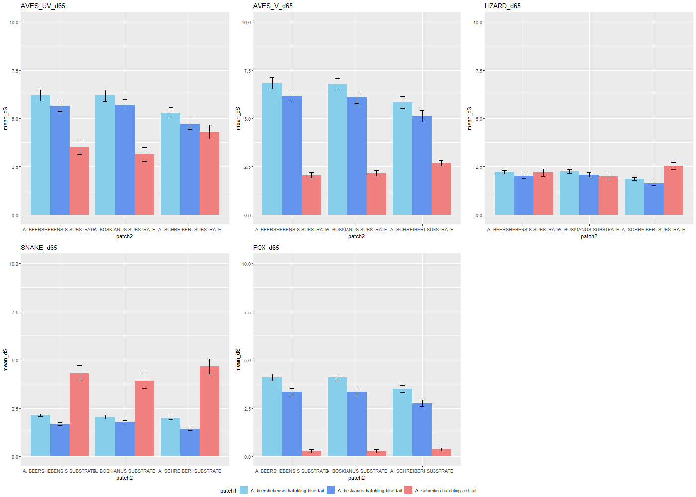
SUBSTRATES
opt. 1
Notes:
NEW

Slide 5
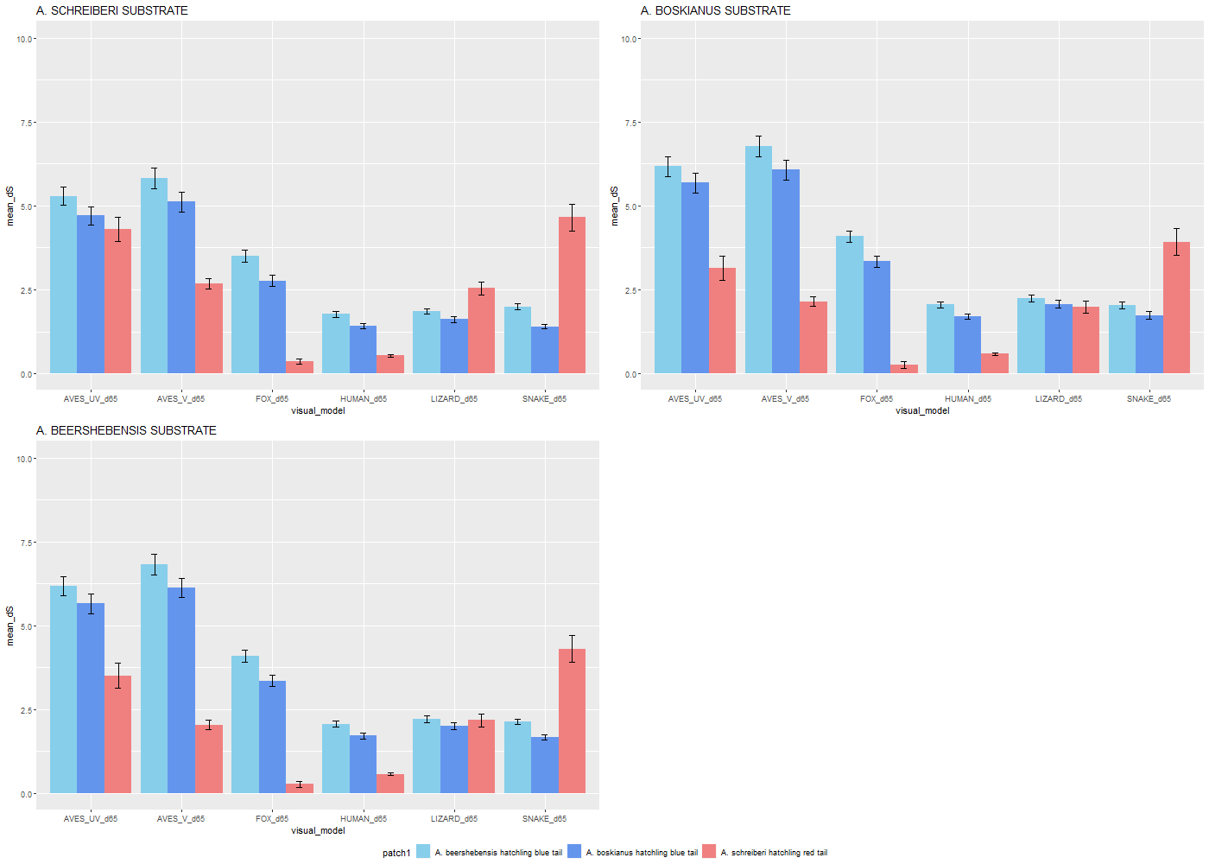
SUBSTRATES
opt. 2
Notes:
NEW

Slide 6
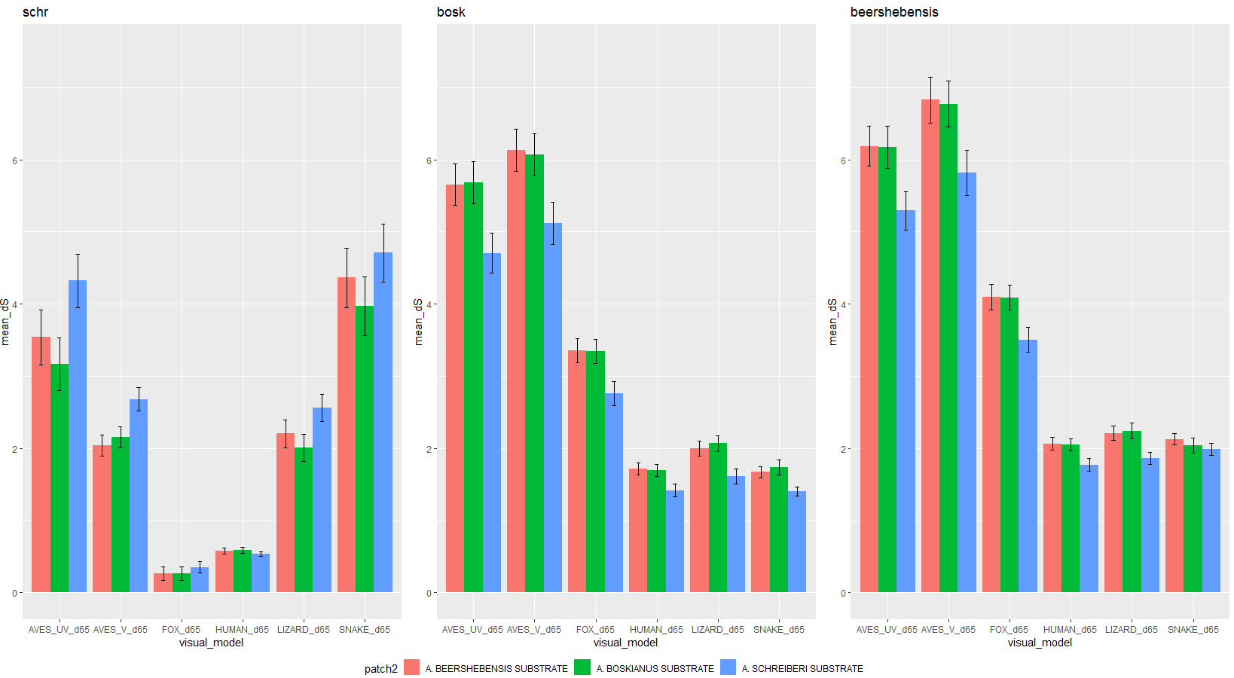
SUBSTRATES- opt. 3
Species:

